Slide 1


Critical Success Factors:
Dotcoms &
Construction Procurement
Berkeley Forum on Procurement and Marketplace Transformation October 18, 2000
Notes:
I bring 3 sets of experiences to the topic that Arie defined. First, two decades of highly varied experiences in IT management, including designing and implementing a metadata data dictionary, and a very active role in the office automation revolution of the 1980’s. It accomplished a lot, but the corporations that were to be paperless by 1990 never got there. Many predictions turn out wrong: the 50’s promised electricity so cheap meters would disappear. For a number of those years I taught the history and sociology of technology at De Paul University, mostly focusing not on information technology, but on the past or on modern medicine. Then, in 1987 I left the corporate world for construction, first as a fabricator of architectural precast concrete. For the past 12 years I have owned, as cofounder then full owner, Cary Concrete Products. Cary is what the semiconductor folks call a fabless manufacturer: design, sell, deliver, with subcontracted manufacturing. We do almost exclusively custom or “plans and specs” work in commercial construction and despite the name, we do it in a wide range of molded materials. I spent many years puzzled by why the industry and process were so chaotic and difficult and I studied it carefully.
Heavyware started as a small internal project within Cary. Ultimately its focus became using the Internet to facilitate sales and delivery of specialized commercial construction products to jobsites and the delivery of product information to desktops.it was based on 3 distinct, phased, value approaches: 1)turning previously custom items into standard catalog products, using unused molds and other types of tooling that remain as valuable, but idle assets at the completion of a project 2) creating an engine for the design/bid/buy/build supply chain, with a product-focused, transactive, content rich, multi-vendor catalog at the center 3) harvesting, organizing, and monetizing all the knowledge assets related to specialized products that today are largely still part of an oral culture in the heads of experienced specialized practitioners scattered around the industry. Heavyware did not close on financing in a timely manner, and is no longer active. Details are on the website.
I bring a relatively unusual perspective, then to this topic.
1) Intensively data-centric
2) Historical and sociological view of technology
3) Real world, intimate jobsite experience with constructing large physical objects and interacting with every player in the supply chain in a variety of roles.

Slide 2
MAJOR THEMES
CUSTOMER AND REAL LIFE FOCUS
WIN/WIN/WIN
  SUPPLIER/BUYER/DOTCOM
STANDARDIZATION
PRODUCT INFORMATION
Notes:
I’ve tried boiling everything down to basics. Some of these themes may seem a bit abstract. I’m discussing them upfront, so they will be more familiar as we encounter them throughout.
CUSTOMER FOCUS means starting with the customer and with the customer’s problems rather than starting with technology and solutions to problems that are of limited importance to the customer. Reality focus says that a steam train needs tracks to be useful. Remember that for later.
WIN/WIN/WIN - The dotcom cannot make money without the other parties. If you do not serve their interests, you will lose their attention. Forget who pays who. You want to think of buyers and of sellers as customers for your services. You must create enough value for them so that you can make money. Does this really work for my customer? For the supplier? Ask it hard. And be sure the numbers work for you, don’t assume it or wish it. Enchantment with a new technology is not a critical success factor.
STANDARDIZATION was a key technology in the 19th century as well as earlier and remains an incredibly powerful technology today. It’s what Ray Kroc and McDonald’s did for hamburger joints and diners, transforming a highly fragmented industry into the modern fast food industry. Standardization of parts was a critical factor in the infrastructure needed for industrial mass production. Standardization is an absolute precondition and critical success factor for much of the seamless integration that B-B ecommerce promises to eventually deliver. RosettaNet is a substantial standardization effort undertaken by the electronic components industry. Without an SKU as a standard identifier for inventory items, current levels of retail supply chain automation would not be possible. Conversion of custom products to standard ones was a powerful value proposition involving HeavyWare’s initial set of products.
PRODUCT INFORMATION is at the absolute dead center of any computerized procurement effort!!! Without it you are very limited in what you can do, for you cannot open inner envelopes and act on them. How much product information you have in a standardized form defines the limits of what you can do, of the scope of your success.

Slide 3
CONTEXT AND OVERVIEW
SUCCESS:
    STOCK PRICE OR OPERATIONAL?
A/E/C DOTCOM WORLD
    MEETING OF TWO RELATED “BUILDERS”
    COMPARE SOFTWARE & CONSTRUCTION
A/E/C, E/P/C AND PROCUREMENT
    DIVERSITY AND SPECIALIZATION
    MUST BE SPECIFIC TO UNDERSTAND
Notes:
We have two metrics for success.
1) Market valuation of stock, whether traded publicly or privately held.2) Profits as reported to IRS according to GAAP.
The connection between them is the subject of lively debate and evolution. What is for certain is that all other things being equal, valuations are higher in the presence of profits than in their absence.
Ultimately, your results by either measure are based how you are perceived. One case centers on how current and potential investors perceive the enterprise, and in the other case, how current and potential customers perceive the enterprise. My focus is only on success as defined as operational profits. Thus, our first critical factor is the ability to define, to understand and to imagine your customer ...and how that customer will perceive your offering.
A/E/C Dotcom joins two similar, project based industries that build “one offs”. The overlap can be a source of familiarity or of misunderstanding.
Specificity To see what is really critical in a system, you have to isolate variables. We have to imagine customers, suppliers, and their procurement-related behavior. Diversity is so great that there may not be a meaningful general or composite contractor. There are distinct groupings. I’ll point to some dimensions of this. Good targeting and segmentation are a critical success factor.. Your choices: 1) imagine multiple core targets 2) restrict yourself to a narrow niche 3) anything else is like designing a virtual “one-size fits all” uniform for Olympic athletes. The solution won’t fit anyone well.
THIS IS NOT YOUR TYPICAL MANUFACTURING SUPPLY CHAIN.

Slide 4
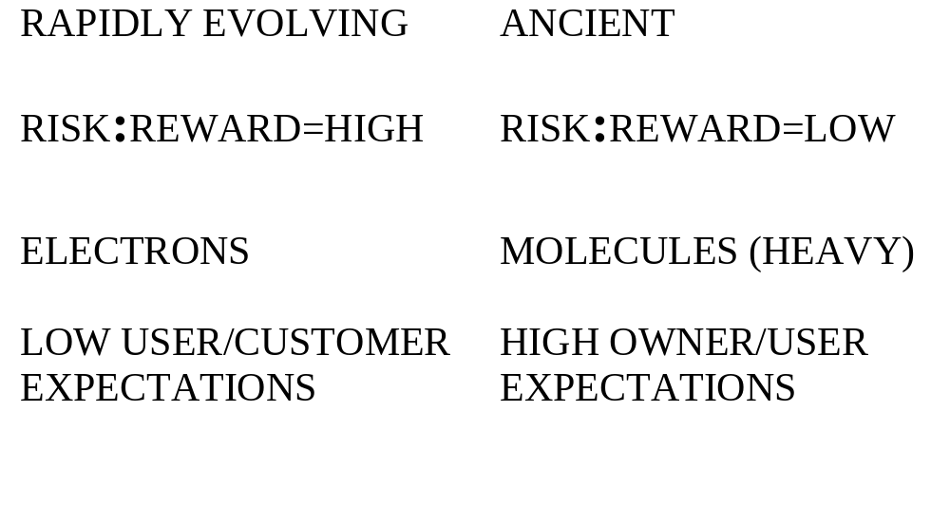
A TALE OF TWO INDUSTRIES
PROJECT-BASED, BUILDING “ONE-OFF’S”
Notes:
Looking at these contrasts, what can we learn?
1. The great contrast in opportunity and even pay is one reason for the unexpectedly high level of investment in a/e/c dotcoms. More rapid money is to be made in a dotcom than is imaginable in construction, where dollars and projects are slowly and laboriously eked out.
2. Customers never forget that they are ultimately paid for building physical structures. Jobsite deliveries today are a combination of pain and expense and aggravation. A critical and minimum requirement for success is neutrality, doing no harm. Increase the aggravation and you can kiss your customer goodbye. Lessen the cost to suppliers or the pain to everyone and your chance of success increases. HeavyWare started addressing this on 2 fronts. We designed load building software so we could always quote delivered prices in real time for a broad range of non-package items (not UPS) in contrast to current practice of quoting FOB plant. We began developing numerous jobsite delivery and storage options as well.
3. Contractors are used to being held accountable for errors and may have high service expectations, including the quaint concept of backcharges. This is part of imagining that customer. And increasingly contractors are involved in detailed design. This means that they need very deep info on products.

Slide 5
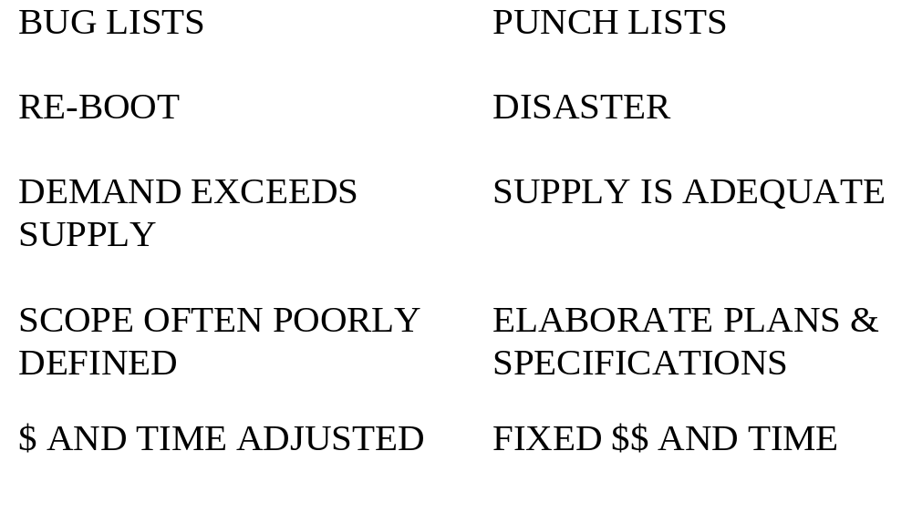
A TALE OF TWO INDUSTRIES
PROJECT-BASED, BUILDING “ONE-OFF’S”

Slide 6
COMMERCIAL CONSTRUCTION
MANUFACTURING INDUSTRY
  NOMADIC (NO FACTORY)
  AD HOC TEAMS COMMON (ALL LEVELS)
NO MASS PRODUCTION
  RESIDENTIAL CONSTRUCTION USES IT
THE FINAL PRODUCT IS A PROTOTYPE
  AFFECTS ALL ASPECTS OF INDUSTRY
Notes:
NOMADIC - By the time they give workers indoor plumbing, they are ready to move on to next job. At every level, the entire team is often assembled on an ad-hoc, project basis.
MASS PRODUCTION - Largest industry without this key 19th century technology. Do use mass-produced products. Standardization of components is a key efficiency issue. Continues to this day. Early in last century, brick became standardized in size. Large scale home builders essentially use mass production. They sell an essentially standard configurable product - what is now known as mass customization. As we shall see later, this affects the components or products -- they are mostly commodities.This in turn presents them with opportunity.
PROTOTYPES - There is a continuum here; degree of novelty varies among types of structures. There are many external factors dictating some of this: local codes, site-specific conditions, the value we place on distinctive buildings, etc.
PROTOTYPE=OPPOSITE OF STANDARD. REVERBERATES THROUGH ALL ASPECTS OF THE INDUSTRY. MISS THIS AND YOU MISS YOUR CUSTOMER!
Contracts
billing
collection
delivery
Since prototypes are the output of the construction industry, there is no physical prototype as in other manufacturing industries. All “prototyping” is done on paper, whether virtual or electronic.

Slide 7
COMMERCIAL CONSTRUCTION
GETTING IT RIGHT THE FIRST TIME
  THE KEY CHALLENGE FOR SUBS
    ONE ERROR CAN KILL THE ENTERPRISE
DISTRIBUTION OF RISK IS A MAJOR RELATIONSHIP ISSUE
  SHIFT RISK DOWN THE SUPPLY CHAIN
    BOTH DESIGN AND EXECUTION
  GC’S WANT TO BE CM’S WITH LESS RISK
Notes:
Folks accustomed to writing software for clients have a taste if the challenge of building large prototypes. However they generally have it easy, since they are deeply involved in requirements and get a sign-off from the owner. Here is an unimaginable scene: The architect walks an owner through a nearly completed structure and the owner, needing to relieve his or herself, asks where the bathrooms are. The architect says, What? You never told me your operation needed bathrooms. Were there a fight, the software person would have a favorable contract to rely on. In construction, one could encounter a scenario in which the architect’s plans showed bathrooms, but an overlooked code requirement or law required the male:female stall ratio to be different than on the plans. The contractor and subs could be solely liable, since the specifications required them all applicable codes and laws.

Slide 8
TECHNOLOGY ADOPTION
BUSINESS FACTORS
  PAIN POINT: IT HAS MY ATTENTION
    GPS PHONES AND WHERE IS MY GUY?
SOCIAL FACTORS
  EARLY ADOPTERS ARE BUYING STATUS
    IN THEIR REFERENCE GROUP (INDUSTRY)
  GPS DOZERS AND X-RAYS:GC’S & M.D.’S
Notes:
I have heard dotcoms in both construction and health care complain in frustration that their potential customers are slow to adopt technology. The true complaint is that they are not adopting “my” technology. Technology that addresses customer-defined pain always has a better chance. Know your customer’s pain. Contractors were early adopters of 2-way radios and of cell phones. If I suspect that my mobile employees are fibbing about errands they are running or their location, then I’m likely to adopt GPS-equipped phones, so I can know where they really are.
Doctors are not fast to adopt web tools. They are generally eager to adopt new, often unproven, medical technologies. A slow-adopting contractor may fork over big bucks for a not-quite-perfected GPS-enabled bulldozer blade. Independently of the business benefits, it’s cool in his circles. Computers do not confer status on contractors, especially those who employ field labor. Pure construction managers are a different story -- they are in an electronic business.
Understand your customer, try to be pulled rather than pushing.

Slide 9
SOFTWARE AS A TOOL
CORE VALUE PROPOSITION:
  CUT LABOR$$ ON KNOWLEDGE WORK
    FEWER EMPLOYEES, SAME RESULTS
    INCREASED FUNCTIONS, SAME COSTS
CORE MECHANISM:
  RE-USE DATA (INFORMATION LEVER)

Slide 10
SOFTWARE AS A TOOL
ALL BUILT STRUCTURES ARE A MANIFESTATION OF A DESIGN
ALWAYS HAS HIGH INFORMATION CONTENT (ACTUAL AND IMPLIED)
INTEGRATION (EXTENSIVE RE-USE) IS A HUGE OPPORTUNITY
Notes:
That BUILT STRUCTURES MANIFEST DESIGN is a data-centric view of the world.
HIGH, CASCADING INFO CONTENT What at first glance is a single design element in turn reflects other information or knowledge. I may use a standard piece of steel, say a W8x24, ASTM A-36 structural I-beam. That designation is a single piece of information that in turn references a known set of physical characteristic, bending strengths, etc. The ASTM (American Society for Testing of Materials) standard, or a different, implied standard, may describe chemical composition and assume certain manufacturing processes.
INTEGRATION (RE-USE): A standard product is in effect a re-use of certain design information. Standards allow re-use of all the information associated with the standard without paying the price for the intellectual labor. Same as software - you call another (standardized) layer and are re-using that data instead of incurring the labor costs to recreate the information. Opportunity constrained by ontological infrastructure. NOTHING IS SEAMLESS TODAY - READ YOUR CONTRACT!!! Every hand-off is accompanied by the maximum possible ducking of responsibility.
Theoretical integration is meaningless -- I have to be able to rely at 100% on transmitted information.
Current environment is one of overpromise and over-optimism. The complexity is much greater than in electronic components. Most people have no understanding of the magnitude of the challenge. Rosetta Net has made great progress, but slower than they expected.

Slide 11
CREATING VALUE SYNERGY
WHAT DATA WILL BE RE-USED?
WHO, EXACTLY, WILL BE USING IT?
WHAT WILL THEY BE DOING?
INTERMEDIARY OR TOOL SELLER?
Notes:
We want the biggest bang for our buck, and that means maximizing the re-uses of data. A data-centric view here is useful, but that does not mean neglecting data grouping or process. Align them all for strength and power in your offering. Have a clear focus.
The first three questions are about the data.
The last is about you, your relationship to your customers.
Harmony and focus are goals.

Slide 12
DIMENSIONS TO CONSIDER
“SPECIAL” VS. STANDARD
SIZE OF TARGET (BUYER OR SELLER)
EXTENT OF PRODUCT DATA
EXTENT OF INTEGRATION

Slide 13
PRODUCT DATA: CATALOGS
A CATALOG IS A CENTRAL REPOSITORY
  EVOLVING BUT CARRIES PRINT LEGACY
    CORE COMMERCE (Many examples today)
    RICH CONTENT (Starting to evolve)
    FULL CONTENT (On the distant horizon)
RELATIONSHIP TO RISK REDUCTION
  SUITABILITY FOR USE INFO
    ALWAYS INCLUDES EXTERNAL INFO
Notes:
CORE COMMERCE
SKU/NAME/MFR/PRICE/
EXTENDED CONTENT
INVENTORY/SCHED
FULL CONTENT
CATALOG IS CENTRAL REPOSITORY
EVOLVING SCOPE: PRINT LEGACY ACTIVE
CORE COMMERCE (Many examples today)
RICH CONTENT (Starting to evolve)
FULL CONTENT (On the distant horizon)
RELATIONSHIP TO RISK REDUCTION
SUITABILITY FOR USE INFO
EXTERNAL INFO External to product and not necessarily “owned” or generated by mfr.

Slide 14
VISIONS OF INTEGRATION
SOFTWARE vs. DOMAIN ISSUE
CLICK+DRAG+DROP+BID+BUY+BUILD
UNSOLVABLE AS GENERAL PROBLEM
CATALOG OF STANDARD OBJECTS
PROGRESS WILL BE SLOW AND SPOTTY
Notes:
CLICK, DRAG, DROP, BID,BUY,BUILD. For this to occur the clickable object must exist and it must know all it needs to know, which can include suitability for use in a highly particular situation (the interface problem). Many of the knottiest problems in evaluating suitability of use occur at the interface of differing materials and products. It does not “belong” to a single object, but to their interaction. The combinatorial arithmetic leads to high complexity. Typically this knowledge is not systematically organized and certainly not systematically distributed.
INSOLUBLE AS GENERAL PROBLEM Software is inherently more conducive to modularity and there is more control over the interface problem. Within a highly constrained area, it is possible to make progress. Dell found articulating the configuration rules for computers to be a challenge.
CATALOG OF STANDARD OBJECTS
-will grow to assemblies
-add complexity over time
- # products
- depth of data
- assemblies
PROGRESS WILL BE VERY SLOW

Slide 15
VISIONS OF INTEGRATION
A REAL-LIFE STUDY IN INTEGRATION
CAD CAN COORDINATE VIEWS (TOOL)
  ARCHITECTURAL vs. STRUCTURAL
SAMPLED 200 VARIOUS PROJECTS
    FULL COORDINATION IN <10% CASES
NOT A TECHNOLOGY ISSUE
  TOOL USER AND INDUSTRY ISSUE
Notes:
CLICK, DRAG, DROP, BID,BUY,BUILD. For this to occur the clickable object must exist and it must know all it needs to know, which can include suitability for use in a highly particular situation (the interface problem). Many of the knottiest problems in evaluating suitability of use occur at the interface of differing materials and products. It does not “belong” to a single object, but to their interaction. The combinatorial arithmetic leads to high complexity. Typically this knowledge is not systematically organized and certainly not systematically distributed.
INSOLUBLE AS GENERAL PROBLEM Software is inherently more conducive to modularity and there is more control over the interface problem. Within a highly constrained area, it is possible to make progress. Dell found articulating the configuration rules for computers to be a challenge.
CATALOG OF STANDARD OBJECTS
-will grow to assemblies
-add complexity over time
- # products
- depth of data
- assemblies
PROGRESS WILL BE VERY SLOW

Slide 16
EMERGING OPPORTUNITY
PRODUCT-RELATED DATA
  FRAGMENTED SOURCES
  NEEDED FOR RISK REDUCTION
  KNOWLEDGE BASE
KNOWLEDGE CAN BE “OWNED”

